Slide 1
Coursera Applied Data Science Capstone Project
The Battle of boroughs in Oslo, Norway
By Roger Barclet

Slide 2
INTRODUCTION – Problem Definition
DATA COLLECTION
APPROACH
EXCECUTION
VISUALIZATIONS
RESULTS
CONCLUSION

Slide 3
INTRODUCTION
Oslo is Norway's capital and by far the largest city, and also one of the oldest cities in the country. Oslo is both a municipality. The city of Oslo (which also includes areas in the neighboring municipalities) has more than one million inhabitants as of 2018.
Oslo is a relatively compact capital. The city center is not so big, and from there one can visit many of the main sights by foot. In addition, the city's public transport is excellent, making it easy to get around when it comes to making long distances.
Problem definition
Help a newly wed couple planning to relocate in Oslo to find the best place to live.
An “affordable” apartment with proximity to popular venues offering a diverse cultural experience
Nearby public transportation

Slide 4
Data Collection
Data was collected from:
Source : https://no.wikipedia.org/wiki/Liste_over_Oslos_bydeler
This data set contains the required information. And we will use this data set to explore various boroughs of Oslo.
Data Source : http://statistikkbanken.oslo.kommune.no/webview/
Site providing the possibility to build own datasets regarding Oslo and export them in different formats.
‘Kvadratmeterpris_og_omsatte_boliger.csv’ real-estate price/sqm from 2008 to 2018 in each Borough
‘Distrikter_i_Oslo.csv’ containing a list over the sub-districts of Oslo:
Data source : Foursquare API
Description : By using this API we will get all the venues in each borough/sub-borough

Slide 5
APPROACH
Collect data Oslo
Collect population data
Collect sqm price
Visualize data (borough, population, property price, education level)
Use Foursquare API to get venues in each borough
Analyze clusters with K-Means
Inference from the results and conclusion

Slide 6
EXCECUTION
After the codes were run

Slide 7
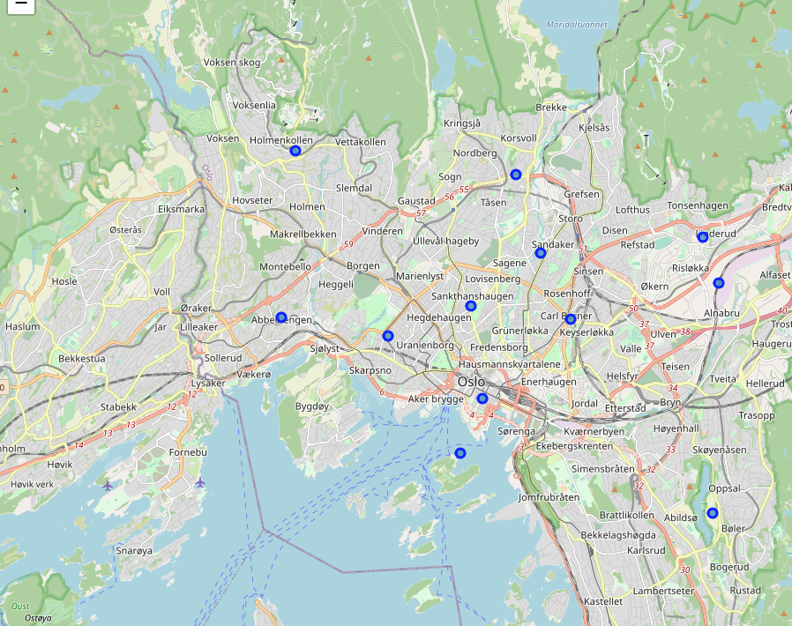
Boroughs of Oslo

Slide 8
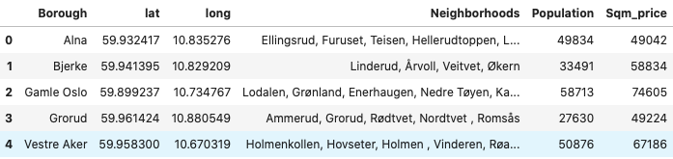
Head of our final dataset

Slide 9
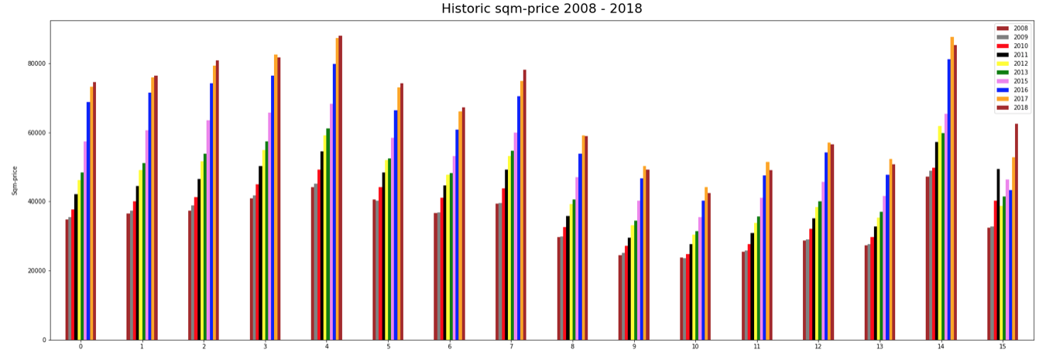
Sqm-price trend in Oslo’s boroughs

Slide 10
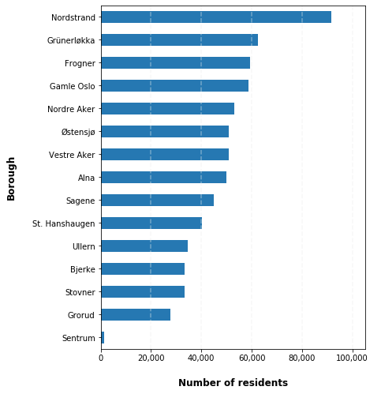
Population pr. borough

Slide 11

RESULTS

Slide 12
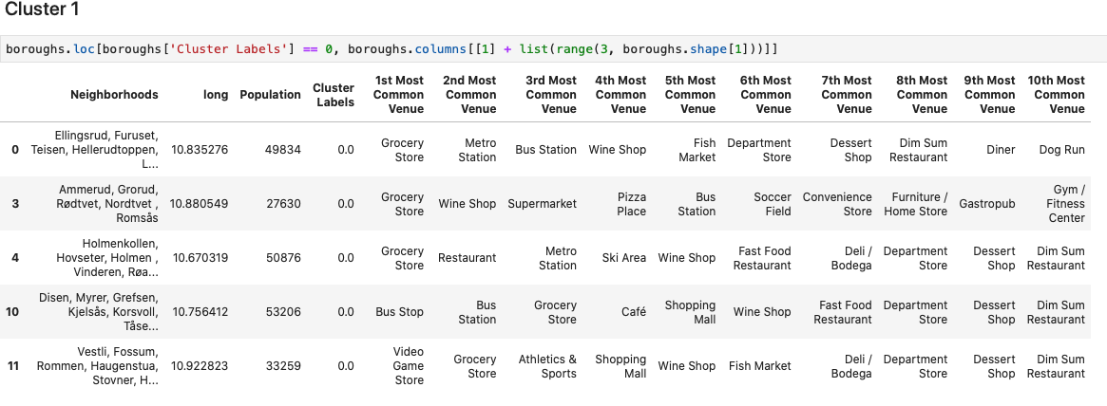
Cluster 1

Slide 13
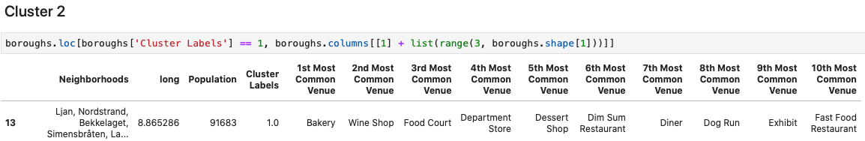
Cluster 2

Slide 14
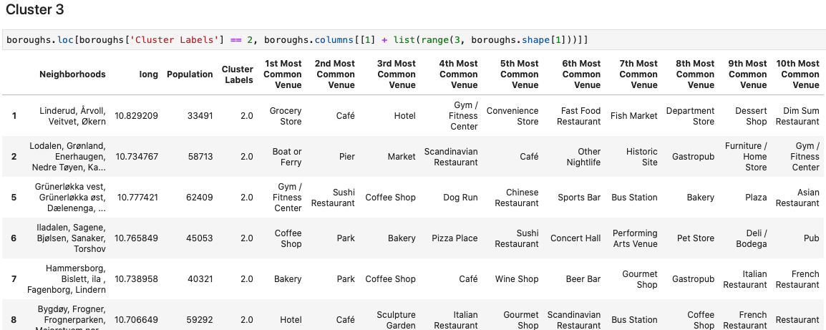
Cluster 3

Slide 15
CONCLUSION
During the analysis, several important statistical features of the boroughs were explored and visualized. Clustering helped highlight optimal areas in terms of venues, and population number. Knowing Oslo I found out that Foursquare doesn’t give the full picture, since many of the venues weren’t fetched.
Helping a couple make a decision about where to live in Oslo was the objective in this project. This objective was met by making use of different sets of data covering boroughs and their associated neighborhoods, population data in each borough and finally sqm price to find out the best place to invest for their housing. We grouped those neighborhoods into clusters and this will contribute in shortlisting their decision.
This has been a great journey and thank you for following me in my analysis.

